Slide 1
Advanced Java Programming B.Sc.CSIT Seventh Semester
By Narayan Subedi

Slide 2
Unit 1. Programming In Java

Slide 3
1.1 Introduction to Java
A general-purpose computer programming language designed to produce programs that will run on any computer system.
A high-level programming language developed by Sun Microsystems.
Games Gosling, OAK 1991, changed to Java in 1995,
OOP - Object Oriented Programming Language
Platform independent
Secure, multithreaded, distributed, portable…

Slide 4
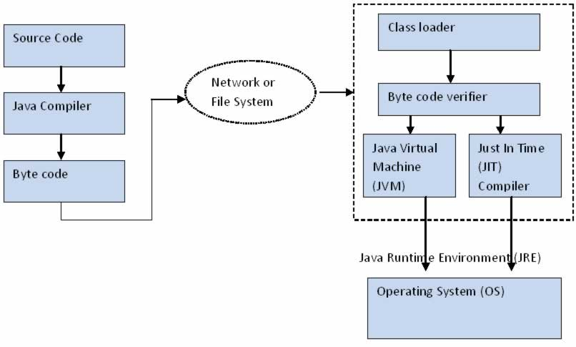
Java Architecture

Slide 5
Java Architecture
Java's architecture arises out of four distinct but interrelated technologies:
The Java programming language
The Java class file format
The Java API (Application Programming Interface)
The JVM (Java Virtual Machine)
Notes:
Although the name "Java" is generally used to refer to the Java programming language, there is more to Java than the language.
The JVM, Java API, and Java class file work together with the language to make Java programs run.

Slide 6
Java Architecture
JVM (Java Virtual Machine) :- The abstract computer on which all Java programs run.
Bytecode is a highly optimized set of instructions designed to be executed by the Java run-time system, which is called the Java Virtual Machine (JVM).
Just-in-time compilation (JIT), also known as dynamic translation, is compilation done during execution of a program – at run time – rather than prior to execution.
The Java Classloader is a part of the Java Runtime Environment that dynamically loads Java classes into the Java Virtual Machine.

Slide 7
Advantages of Java
Java is easy to learn. Java was designed to be easy to use and is therefore easy to write, compile, debug, and learn than other programming languages.
Java is object-oriented. This allows you to create modular programs and reusable code.
Java is platform-independent.

Slide 8
PATH and CLASSPATH Variables
PATH
The PATH is the system variable that your operating system uses to locate needed executables from the command line or Terminal window.
%JAVA_HOME%\bin;
CLASSPATH
The CLASSPATH variable is one way to tell applications, including the JDK tools, where to look for user classes.
The default value of the class path is ".“
-cp command line switch
http://docs.oracle.com/javase/tutorial/essential/environment/paths.html

Slide 9
Compiling and Running Java Programs
Open notepad or any text editor
Type below lines
public class HelloWorld {
public static void main(String[] args) {
System.out.println("Hello World!");
} //end of main
} //end of class
Save file as HelloWorld.java and open CMD
Locate above file and type: javac HelloWorld.java
Again type: java HelloWorld

Slide 10
1.2 Class and Object
Class
A class is the blueprint from which individual objects are created.
In object-oriented programming, a class is an extensible program-code-template for creating objects, providing initial values for state (member variables) and implementations of behavior (member functions, methods).
Example:
class MyClass{
// constructors, methods, variable,
}

Slide 11
1.2 Class and Object
Object
In the class-based object-oriented programming paradigm, "object" refers to a particular instance of a class where the object can be a combination of variables, functions, and data structures.
Example:
MyClass object = new MyClass();

Slide 12
Creating Classes
class Bicycle {
int cadence; int speed ; int gear;
public Bicycle(){
cadence = 0; speed = 0; gear = 1;
}
void changeCadence(int newValue) {
cadence = newValue;
}
void changeGear(int newValue) {
gear = newValue;
}
void speedUp(int increment) {
speed = speed + increment;
}
void applyBrakes(int decrement) {
speed = speed - decrement;
}
void printStates() {
System.out.println("cadence:" +cadence + " speed:" + speed + " gear:" + gear);
}
}

Slide 13
Creating Classes
class BicycleDemo {
public static void main(String[] args) {
// Create two different Bicycle objects
Bicycle bike1 = new Bicycle();
Bicycle bike2 = new Bicycle();
// Invoke methods on those objects
bike1.changeCadence(50);
bike1.speedUp(10);
bike1.changeGear(2);
bike1.printStates();
bike2.changeCadence(50);
bike2.speedUp(10);
bike2.changeGear(2);
bike2.changeCadence(40);
bike2.speedUp(10);
bike2.changeGear(3);
bike2.printStates();
}
}

Slide 14
Interfaces
A Java interface is a bit like a class, except you can only declare methods and variables in the interface.
You cannot actually implement the methods.
Interfaces are a way to achieve polymorphism in Java.
Interfaces cannot be instantiated, but rather are implemented.
A class that implements an interface must implement all of the methods described in the interface, or be an abstract class.
An interface does not contain any constructors.
All of the methods in an interface are abstract.
An interface can extend multiple interfaces
public interface Hockey extends Sports, Event

Slide 15
Interfaces
interface Bicycle {
void changeCadence(int newValue);
void changeGear(int newValue);
void speedUp(int increment);
void applyBrakes(int decrement);
}

Slide 16
Interfaces
class ACMEBicycle implements Bicycle {
int cadence = 0; int speed = 0; int gear = 1;
void changeCadence(int newValue) {
cadence = newValue;
}
void changeGear(int newValue) {
gear = newValue;
}
void speedUp(int increment) {
speed = speed + increment;
}
void applyBrakes(int decrement) {
speed = speed - decrement;
}
void printStates() {
System.out.println("cadence:" + cadence + " speed:" + speed + " gear:" + gear);
}
}

Slide 17
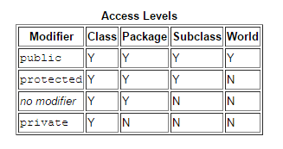
Access Modifiers
Access level modifiers determine whether other classes can use a particular field or invoke a particular method.

Slide 18
Arrays
An array is a data structure that stores a collection of values of the same type.
Declaration:
int[] a;
String[] str ;
Initialization:
a = new int[100];
str = new String[2];
Assigning value:
for (int i = 0; i < 100; i++){
a[i] = i; // fills the array with numbers 0 to 99
}
str[0] = “One”;
str[1] = “Two”;

Slide 19
Packages
A package is a namespace that organizes a set of related classes and interfaces.
Conceptually you can think of packages as being similar to different folders on your computer.
Example:
package animals;
interface Animal {
public void eat();
public void travel();
}
http://www.tutorialspoint.com/java/java_packages.htm

Slide 20
Packages
package animals;
public class MammalInt implements Animal{
public void eat(){ System.out.println("Mammal eats");
}
public void travel(){
System.out.println("Mammal travels");
}
public int noOfLegs(){ return 0; }
public static void main(String args[]){
MammalInt m = new MammalInt();
m.eat();
m.travel();
}
}

Slide 21
Packages
The Directory Structure of Packages:
The name of the package becomes a part of the name of the class.
The name of the package must match the directory structure where the corresponding bytecode resides.
package vehicle;
public class Car { // Class implementation. }
location of file: ....\vehicle\Car.java
Now, the qualified class name and pathname:
Class name -> vehicle.Car
Path name -> vehicle\Car.java (in windows)

Slide 22
Packages
Importing Package:
Syntax : import java.util.*;
package payroll;
public class Boss {
public void payEmployee(Employee e) {
e.mailCheck();
}
}
Note: we assumed that Employee class is in payroll package, if it is in package called employee, then either we use import employee.Employee; before Boss class or directly access it as employee.Employee in payEmployee method.

Slide 23
Inheritance
Inheritance is a mechanism where a new class is derived from an existing class.
Inheritance can be defined as the process where one object acquires the properties of another.
IS-A Relationship:
IS-A is a way of saying : This object is a type of that object.
public class Animal{ }
public class Mammal extends Animal{ }
public class Reptile extends Animal{ }
public class Dog extends Mammal{ }
Now, if we consider the IS-A relationship, we can say:
Mammal IS-A Animal
Reptile IS-A Animal
instanceof
Notes:
Mammal m = new Mammal();
System.out.println(m instanceof Animal);

Slide 24
Inheritance
HAS-A relationship:
This determines whether a certain class HAS-A certain thing.
public class Vehicle{}
public class Speed{}
public class Van extends Vehicle{
private Speed sp;
}
This shows that class Van HAS-A Speed.

Slide 25
Inheritance
Using the Keyword super
public class Superclass {
public void printMethod() { System.out.println("Printed in Superclass.");
}
}
public class Subclass extends Superclass {
// overrides printMethod in Superclass
public void printMethod() {
super.printMethod();
System.out.println("Printed in Subclass");
}
public static void main(String[] args) {
Subclass s = new Subclass();
s.printMethod();
}
}
Try with constructor

Slide 26
1.3 Exception Handling and Threading
Exception Handling
An exception is a problem that arises during the execution of a program.
Checked exceptions:
A checked exception is an exception that is typically a user error or a problem that cannot be foreseen by the programmer.
For example, if a file is to be opened, but the file cannot be found, an exception occurs.
These exceptions cannot simply be ignored at the time of compilation.

Slide 27
Exception Handling
Runtime exceptions:
A runtime exception is an exception that occurs that probably could have been avoided by the programmer.
As opposed to checked exceptions, runtime exceptions are ignored at the time of compilation.
Example: Divide by zero, null value manipulation ..

Slide 28
Exception Handling
Catching Exceptions:
A method catches an exception using a combination of the try and catch keywords.
A try/catch block is placed around the code that might generate an exception
import java.io.*;
public class ExcepTest{
public static void main(String args[]){
try{
int a[] = new int[2];
System.out.println("Access element three :" + a[3]);
}catch(ArrayIndexOutOfBoundsException e){
System.out.println("Exception thrown :" + e);
} finally{
System.out.println(“Finally Block");
}
}
}

Slide 29
Exception Handling
Note the following:
A catch clause cannot exist without a try statement.
It is not compulsory to have finally clauses when ever a try/catch block is present.
The try block cannot be present without either catch clause or finally clause.
Any code cannot be present in between the try, catch, finally blocks.

Slide 30
Exception Handling
The throws/throw Keywords:
If a method does not handle a checked exception, the method must declare it using the throws keyword.
The throws keyword appears at the end of a method's signature.

Slide 31
Creating Multithreaded Programs
Thread
A thread is a thread of execution in a program.
The Java Virtual Machine allows an application to have multiple threads of execution running concurrently.
Threads are independent.
Every thread has a priority.
Threads with higher priority are executed in preference to threads with lower priority.

Slide 32
Creating Multithreaded Programs
Multithreading
Multithreading in java is a process of executing multiple threads simultaneously.
Creating Multithreaded Program using Runnable Interface
Creating Multithreaded Program Extending Thread Class

Slide 33
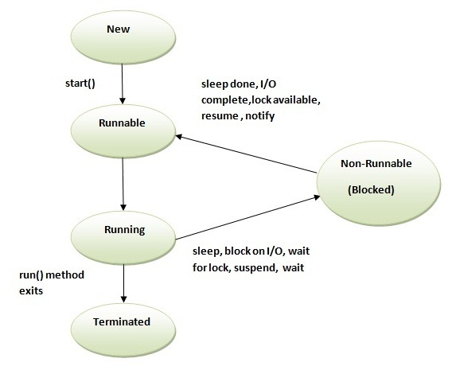
Creating Multithreaded Programs
Thread Life Cycle

Slide 34
Creating Multithreaded Programs
Thread Life Cycle
1) New
The thread is in new state if you create an instance of Thread class but before the invocation of start() method.
2) Runnable
The thread is in runnable state after invocation of start() method, but the thread scheduler has not selected it to be the running thread.
3) Running
The thread is in running state if the thread scheduler has selected it.
4) Non-Runnable (Blocked)
This is the state when the thread is still alive, but is currently not eligible to run.
5) Terminated
A thread is in terminated or dead state when its run() method exits.

Slide 35
Creating Multithreaded Programs
isAlive()
join()

Slide 36
1.4 File IO:
File:
java.io.File
An abstract representation of file and directory pathnames.

Slide 37
File IO
Directories:
java.io.File
A directory is a File which can contains a list of other files and directories. You use File object to create directories, to list down files available in a directory.
String dirname = "/tmp/user/java/bin";
File d = new File(dirname);
// Create directory now.
d.mkdirs();

Slide 38
I/O Stream Classes
FileInputStream A FileInputStream obtains input bytes from a file in a file system.
FileOutputStream A file output stream is an output stream for writing data to a File or to a FileDescriptor.
FileReader Convenience class for reading character files.
FileWriter Convenience class for writing character files.
InputStreamReader …

Slide 39
Byte Streams
Java byte streams are used to perform input and output of 8-bit bytes.
All byte stream classes are descended from InputStream and OutputStream
Though there are many classes related to byte streams but the most frequently used classes are , FileInputStream and FileOutputStream.
Following is an example which makes use of these two classes to copy an input file into an output file:

Slide 40
Byte Streams
import java.io.*;
public class CopyFile {
public static void main(String args[]) throws IOException {
FileInputStream in = null;
FileOutputStream out = null;
try {
in = new FileInputStream("input.txt");
out = new FileOutputStream("output.txt");
int c;
while ((c = in.read()) != -1) {
out.write(c);
}
}finally {
if (in != null) {
in.close();
}
if (out != null) {
out.close();
}
}
}
}

Slide 41
Character Streams
Java Character streams are used to perform input and output for 16-bit unicode.
FileReader and FileWriter.
Reads / Writes two bytes at a time.
Input and output done with stream classes automatically translates to and from the local character set (internationalization ). So, more convenient than Byte Streams.

Slide 42
Character Streams
import java.io.*;
public class CopyFile {
public static void main(String args[]) throws IOException {
FileReader in = null;
FileWriter out = null;
try {
in = new FileReader("input.txt");
out = new FileWriter("output.txt");
int c;
while ((c = in.read()) != -1) {
out.write(c);
}
}finally {
if (in != null) {
in.close();
}
if (out != null) {
out.close();
}
}
}
}

Slide 43
Reading File
import java.io.*;
public class ReadFileExample {
public static void main(String[] args) {
File file = new File("D:/robots.txt");
FileInputStream fis = null;
try {
fis = new FileInputStream(file);
System.out.println("Total file size to read (in bytes) : "
+ fis.available());
int content;
while ((content = fis.read()) != -1) {
// convert to char and display it
System.out.print((char) content);
}
} catch (IOException e) {
e.printStackTrace();
} finally {
try {
if (fis != null)
fis.close();
} catch (IOException ex) {
ex.printStackTrace();
}
}
}
}

Slide 44
Writing to File
import java.io..*;
public class WriteFileExample {
public static void main(String[] args) {
FileOutputStream fop = null;
File file;
String content = "This is the text content";
try {
file = new File("d:/newfile.txt");
fop = new FileOutputStream(file);
// if file doesnt exists, then create it
if (!file.exists()) {
file.createNewFile();
}
// get the content in bytes
byte[] contentInBytes = content.getBytes();
fop.write(contentInBytes);
fop.flush();
fop.close();
System.out.println("Done");
} catch (IOException e) {
e.printStackTrace();
} finally {
try {
if (fop != null) {
fop.close();
}
} catch (IOException e) {
e.printStackTrace();
}
}
}
}

Slide 45
File Input Stream
read() method
Reads a byte of data from this input stream (InputStream class). This method blocks if no input is yet available.
The methods returns the next byte of data, or -1 if the end of the file is reached.

Slide 46
RandomAccessFile
The Java.io.RandomAccessFile class file behaves like a large array of bytes stored in the file system.
Instances of this class support both reading and writing to a random access file.
RandomAccessFile(File file, String mode)

Slide 47
RandomAccessFile

Slide 48
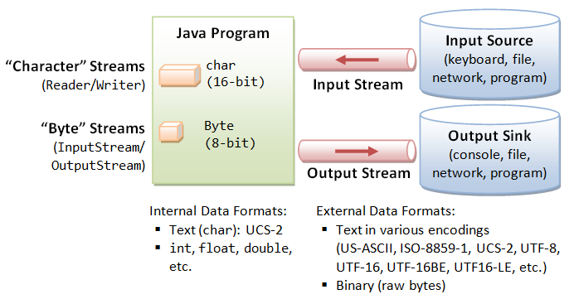
File IO

Slide 49
Introduction to Java NIO
Non-blocking I/O (usually called NIO, and sometimes called "New I/O") is a collection of Java programming language APIs that offer features for intensive I/O operations. Beginning with version 1.4
It supports a buffer-oriented, channel-based approach to I/O operations.
Package java.nio
NIO subsystem does not replace the stream-based I/O classes found in java.io.
NIO buffers
NIO data transfer is based on buffers (java.nio.Buffer and related classes). These classes represent a contiguous extent of memory, together with a small number of data transfer operations.
Notes:
Buffer is a region of a physical memory storage used to temporarily store data while it is being moved from one place to another.

Slide 50
Unit 2: User Interface Components with Swing

Slide 51
2.1 Swing and MVC Design Patterns
Swing
Swing is a GUI widget toolkit for Java.
It is part of Oracle's Java Foundation Classes (JFC) — an API for providing a graphical user interface (GUI) for Java programs.
FC consists of the Abstract Window Toolkit (AWT), Swing and Java 2D.
Swing is currently in the process of being replaced by JavaFX.

Slide 52
Design Patterns
A design pattern in architecture and computer science is a formal way of documenting a solution to a design problem in a particular field of expertise.
The idea was introduced by the architect Christopher Alexander in the field of architecture and has been adapted for various other disciplines, including computer science.
MVC Pattern
Singleton Pattern
Factory Pattern
http://www.tutorialspoint.com/design_pattern/
Notes:
Design patterns are solutions to general problems that software developers faced during software development.

Slide 53
MVC Pattern
MVC Pattern is a software architectural pattern for implementing user interfaces.
It divides a given software application into three interconnected parts, i.e. Model, View and Controller.
The Model, which stores the content
The View, which displays the content
The Controller, which handles user input

Slide 54
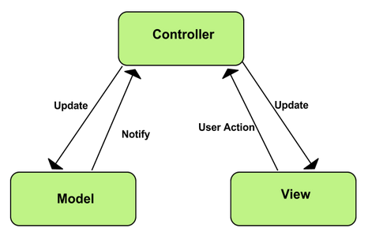
MVC Pattern

Slide 55
MVC Analysis of Swing Buttons
Swing Buttons use MVC Pattern internally
DefaultButtonModel implements ButtonModel which can define the state of the various kinds of buttons. Model provides information like whether the button is Enabled, is Pressed …
JButton button = new JButton("Blue"); ButtonModel model = button.getModel();
model.isEnabled();
The JButton uses a class called BasicButtonUI for the view and a class called ButtonUIListener as controller.

Slide 56
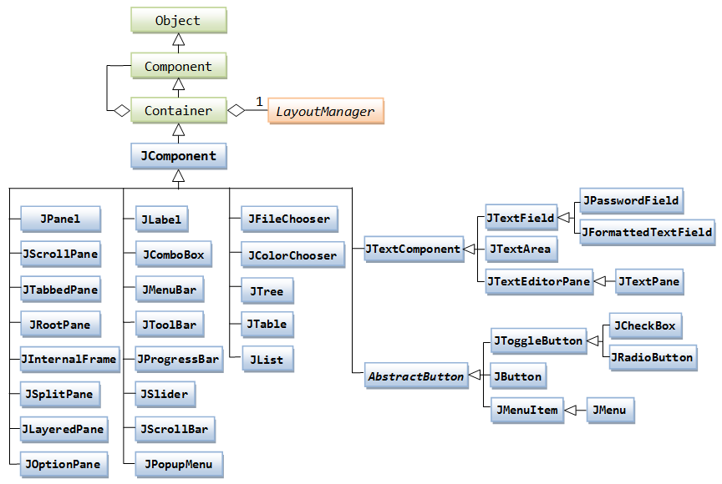
Swing Container Hierarchy

Slide 57
2.2 Layout Management
Layout Manager
A layout manager is an object that implements the LayoutManager interface and determines the size and position of the components within a container.
Setting the Layout Manager
Using the JPanel constructor. For example:
JPanel panel = new JPanel(new BorderLayout());
Using setLayout method. For example:
Container contentPane = frame.getContentPane(); contentPane.setLayout(new FlowLayout());

Slide 58
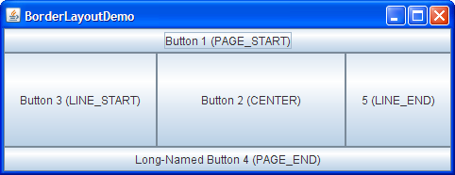
Layout Management
Border Layout
A BorderLayout places components in up to five areas: top, bottom, left, right, and center.
All extra space is placed in the center area.
BorderLayout(int horizontalGap, int verticalGap)

Slide 59
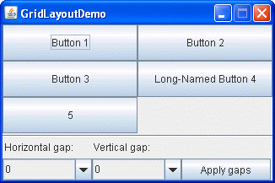
Layout Management
Grid Layout
GridLayout simply makes a bunch of components equal in size and displays them in the requested number of rows and columns.
GridLayout(int rows, int cols)
GridLayout(int rows, int cols, int hgap, int vgap)

Slide 60
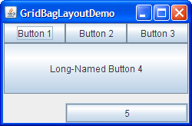
Layout Management
Gridbag Layout
GridBagLayout is a sophisticated, flexible layout manager.
It aligns components by placing them within a grid of cells, allowing components to span more than one cell.
The rows in the grid can have different heights, and grid columns can have different widths.

Slide 61
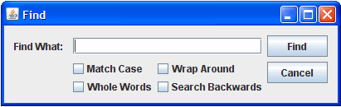
Layout Management
Group Layout
GroupLayout works with the horizontal and vertical layouts separately.
The layout is defined for each dimension independently.
Consequently, however, each component needs to be defined twice in the layout.
http://docs.oracle.com/javase/tutorial/uiswing/layout/groupExample.html

Slide 62
Layout Management
Using No Layout Manager
There will be times when you don’t want to bother with layout managers but just want to drop a component at a fixed location (sometimes called absolute positioning).
1. Set the layout manager to null.
2. Add the component you want to the container.
3. Specify the position and size that you want:
frame.setLayout(null); JButton ok = new JButton("OK"); frame.add(ok); ok.setBounds(10, 10, 30, 15);
void setBounds(int x, int y, int width, int height)
moves and resizes a component.

Slide 63
Layout Management
Custom layout Managers
Every layout manager must implement at least the following five methods, which are required by the LayoutManager interface:
void addLayoutComponent(String s, Component c);
void removeLayoutComponent(Component c);
Dimension preferredLayoutSize(Container parent);
Dimension minimumLayoutSize(Container parent);
void layoutContainer(Container parent);

Slide 64
Layout Management
void addLayoutComponent(String, Component) Called by the Container class's add methods. Layout managers that do not associate strings with their components generally do nothing in this method.
void removeLayoutComponent(Component) Called by the Container methods remove and removeAll. Layout managers override this method to clear an internal state they may have associated with the Component.
Dimension preferredLayoutSize(Container) Called by the Container class's getPreferredSize method, which is itself called under a variety of circumstances. This method should calculate and return the ideal size of the container, assuming that the components it contains will be at or above their preferred sizes. This method must take into account the container's internal borders, which are returned by the getInsets method.
Dimension minimumLayoutSize(Container) Called by the Container getMinimumSize method, which is itself called under a variety of circumstances. This method should calculate and return the minimum size of the container, assuming that the components it contains will be at or above their minimum sizes. This method must take into account the container's internal borders, which are returned by the getInsets method.
void layoutContainer(Container) Called to position and size each of the components in the container. A layout manager's layoutContainer method does not actually draw components. It simply invokes one or more of each component's setSize, setLocation, and setBounds methods to set the component's size and position.

Slide 65
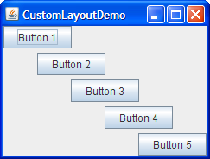
Layout Management
http://docs.oracle.com/javase/tutorial/uiswing/layout/custom.html

Slide 66
2.3 Text Input

Slide 67
2.4 Choice Components:

Slide 68
2.5 Menus:
A menu bar at the top of a window contains the names of the pull-down menus. Clicking on a name opens the menu containing menu items and submenus.

Slide 69
2.5 Menus:
Keyboard Mnemonics
JMenuItem aboutItem = new JMenuItem("About", 'A');
JMenu helpMenu = new JMenu("Help"); helpMenu.setMnemonic('H');
Accelerators
Use the setAccelerator method to attach an accelerator key to a menu item.
The setAccelerator method takes an object of type Keystroke.
openItem.setAccelerator(KeyStroke.getKeyStroke("ctrl O"));

Slide 70
2.5 Menus:
Enabling and Disabling Menu Items
To enable or disable a menu item, use the setEnabled method:
saveItem.setEnabled(false);

Slide 71
2.5 Menus:
Toolbars
A toolbar is a button bar that gives quick access to the most commonly used commands in a program.
What makes toolbars special is that you can move them elsewhere.
JToolBar bar = new JToolBar(); bar.add(blueButton);
Tooltips
Tooltip is a info label displayed over a button when mouse hover’s in it.
blueButton.setToolTipText("Blue Button");

Slide 72
2.6 Dialog Boxes:
Modal dialog box
A modal dialog box won’t let users interact with the remaining windows of the application until he or she deals with it. Eg. a file dialog box
Modeless dialog box
A modeless dialog box lets the user enter information in both the dialog box and the remainder of the application. Eg. a toolbar.

Slide 73

2.6 Dialog Boxes:
Option Dialogs
The JOptionPane has four static methods to show dialogs:
JOptionPane.showMessageDialog(null, "alert", "alert", JOptionPane.ERROR_MESSAGE);
http://docs.oracle.com/javase/7/docs/api/javax/swing/JOptionPane.html

Slide 74
2.6 Dialog Boxes:
Creating Dialogs
In your new dialogbox class extend JDialog class
In the constructor of your dialog box, call the constructor of the superclass JDialog.
Add the user interface components of the dialog box.
Add the event handlers.
Set the size for the dialog box.
When you call the superclass constructor, you will need to supply the owner frame, the title of the dialog, and the modality.
The owner frame controls where the dialog is displayed.
The modality specifies which other windows of your application are blocked while the dialog is displayed

Slide 75
2.6 Dialog Boxes:
Creating Dialog Example

Slide 76
2.6 Dialog Boxes:
Data Exchange Example

Slide 77
2.6 Dialog Boxes:
File Choosers
Swing provides a JFileChooser class that allows you to display a file dialog box.
showOpenDialog to display a dialog for opening a file
showSaveDialog to display a dialog for saving a file
The button for accepting a file is then automatically labeled Open or Save.
You can also supply your own button label with the showDialog method.

Slide 78
2.6 Dialog Boxes:
File Choosers Steps
Make a JFileChooser object. For example: JFileChooser chooser = new JFileChooser();
Set the directory by calling the setCurrentDirectory method.For example, to use the current working directory chooser.setCurrentDirectory(new File("."));
If you have a default file name that you expect the user to choose: chooser.setSelectedFile(new File(filename));
Show the dialog box by calling : int result = chooser.showOpenDialog(parent); int result = chooser.showSaveDialog(parent); You can also call the showDialog method and pass an explicit text for the approve button: int result = chooser.showDialog(parent, "Select");

Slide 79
2.6 Dialog Boxes:
File Choosers Example:

Slide 80
2.6 Dialog Boxes:
Color Choosers:
Except JFileChooser class, Swing provides only one additional chooser, the JColorChooser.
Use it to let users pick a color value.
Color selectedColor = JColorChooser.showDialog(parent, title, initialColor);

Slide 81
Java Architecture

Slide 82
Local Applets
<applet
codebase="tictactoe"
code="TicTacToe.class"
width=120
height=120>
</applet>

Slide 83
Remote Applets
A remote applet is one that is located on another computer system.
This computer system may be located in the building next door or it may be on the other side of the world-it makes no difference to your Java-compatible browser.
No matter where the remote applet is located, it's downloaded onto your computer via the Internet. Your browser must, of course, be connected to the Internet at the time it needs to display the remote applet.

Slide 84
Remote Applets
<applet codebase="http://www.myconnect.com/applets/"
code="TicTacToe.class"
width=120
height=120>
</applet>
In the first case, codebase specifies a local folder, and in the second case, it specifies the URL at which the applet is located.

Slide 85
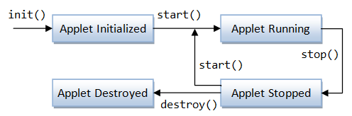
Life Cycle of an Applet

Slide 86
Life Cycle of an Applet
init: This method is intended for whatever initialization is needed for your applet. It is called after the param tags inside the applet tag have been processed.
start: This method is automatically called after the browser calls the init method. It is also called whenever the user returns to the page containing the applet after having gone off to other pages.

Slide 87
Life Cycle of an Applet
stop: This method is automatically called when the user moves off the page on which the applet sits. It can, therefore, be called repeatedly in the same applet.
destroy: This method is only called when the browser shuts down normally. Because applets are meant to live on an HTML page, you should not normally leave resources behind after a user leaves the page that contains the applet.

Slide 88
Life Cycle of an Applet
paint: Invoked immediately after the start() method, and also any time the applet needs to repaint itself in the browser. The paint() method is actually inherited from the java.awt.

Slide 89
Distributed Application using RMI

Slide 90
Distributed Application
A distributed application is software that is executed or run on multiple computers within a network.
These applications interact in order to achieve a specific goal or task.
Traditional applications relied on a single system to run them. Even in the client-server model, the application software had to run on either the client, or the server that the client was accessing. However, distributed applications run on both simultaneously.
The very nature of an application may require the use of a communication network that connects several computers: for example, data produced in one physical location and required in another location.

Slide 91
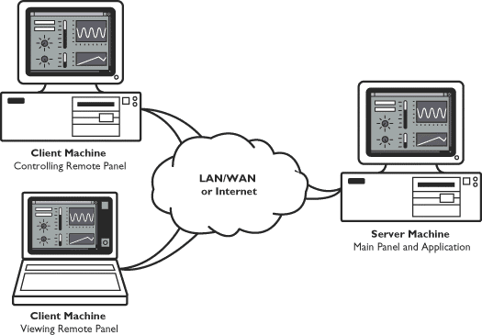
Distributed Application
There are many cases in which the use of a single computer would be possible in principle, but the use of a distributed system is beneficial for practical reasons. For example, it may be more cost-efficient to obtain the desired level of performance by using a cluster of several low-end computers, in comparison with a single high-end computer.

Slide 92
Remote Method Invocation (RMI)
Remote Method Invocation (RMI) allows a Java object that executes on one machine to invoke a method of a Java object that executes on another machine.
This is an important feature, because it allows you to build distributed applications.

Slide 93
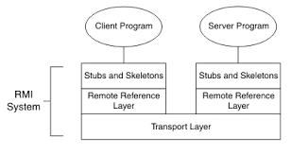
RMI Layers
Stub and Skeleton Layer
The stub and skeleton layer is responsible for marshaling and unmarshaling the data and transmitting and receiving them to/from the Remote Reference Layer
Remote Reference Layer
The Remote reference layer is responsible for carrying out the invocation.
Transport Layer
The Transport layer is responsible for setting up connections, managing requests, monitoring them and listening for incoming calls

Slide 94
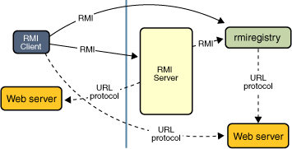
RMI Mechanism
Locate remote objects. Applications can use various mechanisms to obtain references to remote objects. For example, an application can register its remote objects with RMI's simple naming facility, the RMI registry.
Communicate with remote objects. Details of communication between remote objects are handled by RMI.
Load class definitions for objects that are passed around. Because RMI enables objects to be passed back and forth, it provides mechanisms for loading an object's class definitions as well as for transmitting an object's data.

Slide 95
RMI Registry
Essentially the RMI registry is a place for the server to register services it offers and a place for clients to query for those services.
RMI Registry acts a broker between RMI servers and the clients.
A Simple Client/Server Application Using RMI
This section provides step-by-step directions for building a simple client/server application by using RMI. The server receives a request from a client, processes it, and returns a result.

Slide 96
Java Network Programming

Slide 97
Java Network Programming
Introduction to Network Programming
The term network programming refers to writing programs that execute across multiple devices (computers), in which the devices are all connected to each other using a network.
The java.net package of the J2SE APIs contains a collection of classes and interfaces that provide the low-level communication details, allowing you to write programs that focus on solving the problem at hand.

Slide 98
Java Network Programming
TCP:
TCP stands for Transmission Control Protocol, which allows for reliable communication between two applications. TCP is typically used over the Internet Protocol, which is referred to as TCP/IP.
UDP:
UDP stands for User Datagram Protocol, a connection-less protocol that allows for packets of data to be transmitted between applications.
The speed for TCP is slower than UDP. UDP is faster because there is no error-checking for packets.
In TCP, there is absolute guarantee that the data transferred remains intact and arrives in the same order in which it was sent. In UDP, there is no guarantee that the messages or packets sent would reach at all.

Slide 99
Java Network Programming
IP Address : (Ex: 192.168.1.1)
An Internet Protocol address (IP address) is a numerical label assigned to each device (e.g., computer, printer) participating in a computer network that uses the Internet Protocol for communication.
Port Number:
In TCP/IP and UDP networks, an endpoint to a logical connection. The port number identifies what type of port it is. For example, port 80 is used for HTTP traffic.

Slide 100
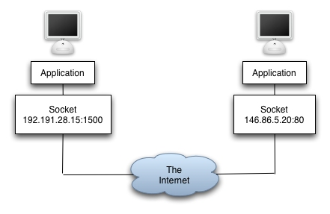
Java Network Programming
Socket:
A socket is one endpoint of a two-way communication link between two programs running on the network. A socket is bound to a port number so that the TCP layer can identify the application that data is destined to be sent to.
An endpoint is a combination of an IP address and a port number. Every TCP connection can be uniquely identified by its two endpoints. That way you can have multiple connections between your host and the serve

Slide 101
Java Network Programming
URL
It is an acronym for Uniform Resource Locator and is a reference (an address) to a resource on the Internet. A URL has two main components: Protocol identifier: For the URL http://example.com , the protocol identifier is http . Resource name: For the URL http://example.com , the resource name is example.com .
java.net.URL
Class URL represents a Uniform Resource Locator, a pointer to a "resource" on the World Wide Web. A resource can be something as simple as a file or a directory, or it can be a reference to a more complicated object, such as a query to a database or to a search engine.

Slide 102
Java Network Programming
java.net.URLConnection
The abstract class URLConnection is the superclass of all classes (HttpURLConncetion…) that represent a communications link between the application and a URL. Instances of this class can be used both to read from and to write to the resource referenced by the URL. In general, creating a connection to a URL is a multistep process using openConnection() and connect()
The connection object is created by invoking the openConnection method on a URL.
The setup parameters and general request properties are manipulated.
The actual connection to the remote object is made, using the connect method.
The remote object becomes available. The header fields and the contents of the remote object can be accessed.

Slide 103
Java Network Programming
URL & URLConnection Example

Slide 104
Java Network Programming
Creating a client/server application using TCP Sockets
Creating a client/server application using UDP Datagram

Slide 105
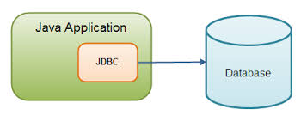
Java Database Programming

Slide 106
Java Database Programming
Relational Database Overview
A database is a means of storing information in such a way that information can be retrieved from it.
In simplest terms, a relational database is one that presents information in tables with rows and columns.
A table is referred to as a relation in the sense that it is a collection of objects of the same type (rows).
Data in a table can be related according to common keys or concepts, and the ability to retrieve related data from a table is the basis for the term relational database. A Database Management System (DBMS) handles the way data is stored, maintained, and retrieved.
In the case of a relational database, a Relational Database Management System (RDBMS) performs these tasks.

Slide 107
Java Database Programming
JDBC API
JDBC API is a Java API that can access any kind of tabular data, especially data stored in a Relational Database. JDBC works with Java on a variety of platforms, such as Windows, Mac OS, and the various versions of UNIX.
java.sql package

Slide 108
Java Database Programming
Driver Manager and JDBC Drivers
JDBC drivers implement the defined interfaces in the JDBC API for interacting with your database server.
An individual database system is accessed via a specific JDBC driver that implements the java.sql.Driver interface.
Drivers exist for nearly all popular RDBMS systems, though few are available for free.
Sun bundles a free JDBC-ODBC bridge driver with the JDK to allow access to standard ODBC data sources, such as a Microsoft Access database.
An easy way to load the driver class is to use the Class.forName() method:
Class.forName("sun.jdbc.odbc.JdbcOdbcDriver");

Slide 109
Java Database Programming
Driver Manager and JDBC Drivers
When the driver is loaded into memory, it registers itself with the java.sql.DriverManager class as an available database driver.
The next step is to ask the DriverManager class to open a connection to a given database, where the database is specified by a specially formatted URL. The method used to open the connection is DriverManager.getConnection() . It returns a class that implements the java.sql.Connection interface:
Connection con = DriverManager.getConnection("jdbc:odbc:somedb", "user", "passwd");

Slide 110
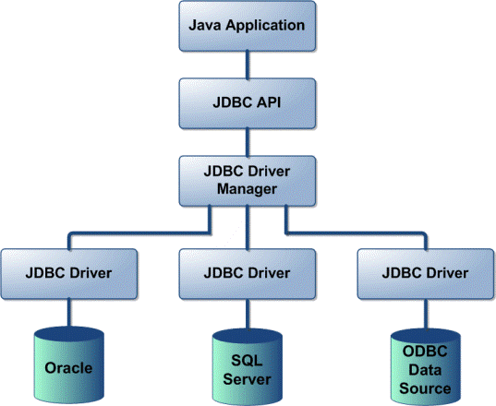
Java Database Programming
JDBC Driver Types
JDBC driver implementations vary because of the wide variety of operating systems and hardware platforms in which Java operates.
Sun has divided the implementation types into four categories, Types 1, 2, 3, and 4, which is explained below:
Type 1: JDBC-ODBC Bridge Driver:
Type 2: JDBC-Native API:
Type 3: JDBC-Net pure Java:
Type 4: 100% pure Java:
Reference
http://www.tutorialspoint.com/jdbc/jdbc-driver-types.htm

Slide 111
Java Database Programming
Introduction to ODBC
ODBC (Open Database Connectivity) is a standard programming language middleware API for accessing database management systems (DBMS).
The designers of ODBC aimed to make it independent of database systems and operating systems. An application written using ODBC can be ported to other platforms, both on the client and server side, with few changes to the data access code.
ODBC was originally developed by Microsoft during the early 1990s.

Slide 112
Java Database Programming
Connecting Database using JDBC ODBC Driver

Slide 113
Web Programming Using Java Servlet APIs

Slide 114
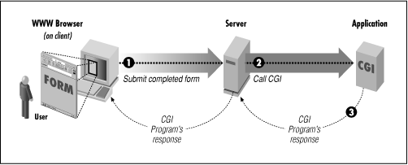
Web Programming Using Java Servlet APIs
Introduction to CGI
Common Gateway Interface (CGI) are programs run by the web server (at "server side").
CGI is a standard method used to generate dynamic content on Web pages and Web applications. CGI, when implemented on a Web server, provides an interface between the Web server and programs that generate the Web content.

Slide 115
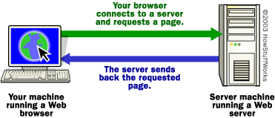
Web Programming Using Java Servlet APIs
Introduction to Web Server
A Web Server is a computer system that processes requests via HTTP.
The term can refer either to the entire system, or specifically to the software that accepts and supervises the HTTP requests.
The most common use of web servers is to host websites, but there are other uses such as gaming, data storage, running enterprise applications, handling email, FTP, or other web uses.

Slide 116
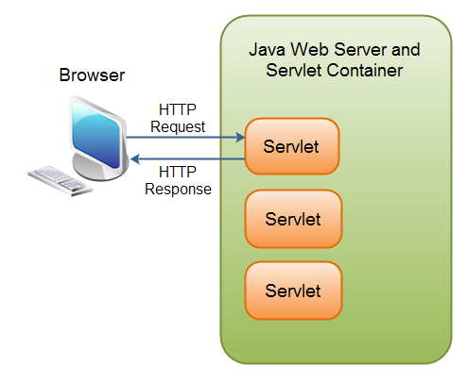
Web Programming Using Java Servlet APIs
Servlet Defination
A Servlet is a small Java program that runs within a Web server.
Servlets receive and respond to requests from Web clients, usually across HTTP, the HyperText Transfer Protocol.
To implement this interface, you can write a generic servlet that extends javax.servlet.GenericServlet or an HTTP servlet that extends javax.servlet.http.HttpServlet.

Slide 117
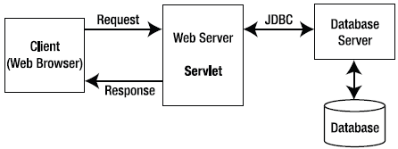
Web Programming Using Java Servlet APIs
HTTP request response model of Servlet

Slide 118
Web Programming Using Java Servlet APIs
Advantages of Servlet over CGI
Better performance: because it creates a thread for each request not process.
Portability: because it uses java language.
Robust: Servlets are managed by JVM so no need to worry about momory leak, garbage collection etc.
Secure: because it uses java language.
Reference
http://www.dineshonjava.com/2013/12/advantages-of-servlets-over-cgi.html#.VMTkxixsvm4
Notes:
A process is an executing instance of an application.

Slide 119
Web Programming Using Java Servlet APIs
Servlet Life Cycle Methods
The init() method :
The init method is designed to be called only once. It is called when the servlet is first created, and not called again for each user request.
public void init() throws ServletException { // Initialization code... }
The service() method :
The servlet container (i.e. web server) calls the service() method to handle requests coming from the client( browsers) and to write the formatted response back to the client.
The service () method is called by the container and service method invokes doGet, doPost, doPut, doDelete, etc. methods as appropriate.
public void service(ServletRequest request, ServletResponse response) throws ServletException, IOException{ }
Notes:
A process is an executing instance of an application.

Slide 120
Web Programming Using Java Servlet APIs
Servlet Life Cycle Methods
The doGet() Method
A GET request results from a normal request for a URL or from an HTML form that has no METHOD specified and it should be handled by doGet() method.
public void doGet(HttpServletRequest request, HttpServletResponse response) throws ServletException, IOException { // Servlet code }
The doPost() Method
A POST request results from an HTML form that specifically lists POST as the METHOD and it should be handled by doPost() method.
public void doPost(HttpServletRequest request, HttpServletResponse response) throws ServletException, IOException { // Servlet code }
Notes:
A process is an executing instance of an application.

Slide 121
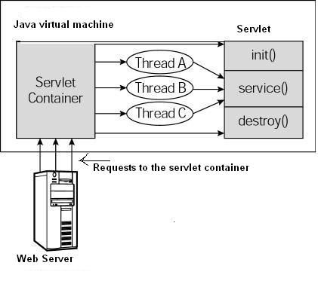
Web Programming Using Java Servlet APIs
Servlet Life Cycle Methods
The destroy() method :
The destroy() method is called only once at the end of the life cycle of a servlet.
public void destroy() { // Finalization code... }
Notes:
A process is an executing instance of an application.

Slide 122
Web Programming Using Java Servlet APIs
Servlet API
javax.servlet
The javax.servlet package contains a number of classes and interfaces that describe and define the contracts between a servlet class and the runtime environment provided for an instance of such a class by a conforming servlet container.
RequestDispatcher : Defines an object that receives requests from the client and sends them to any resource (such as a servlet, HTML file, or JSP file) on the server.
Servlet: Defines methods that all servlets must implement.
ServletConfig : A servlet configuration object used by a servlet container to pass information to a servlet during initialization. ServletContext : Defines a set of methods that a servlet uses to communicate with its servlet container, for example, to get the MIME type of a file, dispatch requests, or write to a log file. …
Notes:
A process is an executing instance of an application.

Slide 123
Web Programming Using Java Servlet APIs
Creating Java Servlet
Compile
servlet-api.jar should be included while doing compile
javac -cp .;F:\apache-tomcat-7.0.23\lib\servlet-api.jar HelloWorld.java
A HelloWolrld.class will be created if compile is success.
Deploy
Copy HelloWorld.class into <Tomcat-installation-directory>/webapps/ROOT/WEB-INF/classes
Notes:
A process is an executing instance of an application.

Slide 124
Web Programming Using Java Servlet APIs
Create following entries in web.xml file located in <Tomcat-installation-directory>/webapps/ROOT/WEB-INF/
<servlet>
<servlet-name>HelloWorld</servlet-name>
<servlet-class>HelloWorld</servlet-class>
</servlet>
<servlet-mapping>
<servlet-name>HelloWorld</servlet-name>
<url-pattern>/HelloWorld</url-pattern>
</servlet-mapping>
Above entries to be created inside <web-app>...</web-app> of web.xml
Now start Tomcat (startup.bat in bin folder of Tomcat installation) and hit http://localhost:8080/HelloWorld in browser.
Notes:
A process is an executing instance of an application.

Slide 125
Web Programming Using Java Servlet APIs
Session
A period devoted to a particular activity.
A session is a way to store information (in variables) to be used across multiple pages.
Saving in Session
String username=request.getParameter("txtusername");
HttpSession session = request.getSession(true);
session.setAttribute("username", username);
Getting from Session
String username=(String) session.getAttribute("username");
//session.invalidate()

Slide 126
Web Programming Using Java Servlet APIs
Cookie
A cookie, also known as an HTTP cookie, web cookie, Internet cookie, or browser cookie, is a small piece of data sent from a website (web application) and stored in a user's web browser while the user is browsing that website (web app).
A cookie, the information is stored on the user’s computer.
Creating Cookie
String username=request.getParameter("txtUsername");
Cookie cookie=new Cookie("username", username); cookie.setMaxAge(60*60*24*30); response.addCookie(cookie);

Slide 127
Web Programming Using Java Servlet APIs
Getting Cookie
Cookie cookies[] = request.getCookies();
Cookie mycookie = null;
if (cookies != null) {
for (int i = 0; i < cookies.length; i++) {
if (cookies[i].getName().equals("username")) {
mycookie = cookies[i];
break;
}
}
}
String userName = mycookie.getValue();

Slide 128
Introductory Concept of Java Beans

Slide 129
Introductory Concept of Java Beans
Java Beans
JavaBeans are classes that encapsulate many objects into a single object (the bean).
They are serializable, have a 0-argument constructor, and allow access to properties using getter and setter methods.
The name "Bean" was to encompass this standard, which aims to create reusable software components for Java.
There is no restriction on the capability of a Bean.
It may perform a simple function, such as obtaining an inventory value, or a complex function, such as forecasting the performance of a stock portfolio.

Slide 130
Introductory Concept of Java Beans
Bean Development Kit (BDK)
BDK is (according to allinterview.com):
Bean Development Kit is a tool that enables to create,configure and connect a set of Beans and it can be used to test Beans without writing a code.
and according to mindprods glossary:
Bean Development Kit. It is now obsolete. Code-building features of modern IDEs take over much of the function of the BDK.
Bean Builder
Bean Builder is a pure Java application, built over market proven and open standards such as XML, Java Beans, and JFC/Swing.
http://www.cs.wustl.edu/~kjg/cs102/Notes/JavaBeans/
http://www.javaworld.com/article/2077005/client-side-java/the-beanbox--sun-s-javabeans-test-container.html

Slide 131
Introductory Concept of Java Beans
Persistance
Persistence is the ability to save the current state of a Bean, including the values of a Bean’s properties and instance variables, to nonvolatile storage and to retrieve them at a later time.
Take Reference from below provided ebook
CHAPTER 29 Java Beans
Java: The Complete Reference™ - Herbert Schildt

Slide 132
Introductory Concept of Java Beans
Creating a New Bean

Slide 133
Questions ???

